Slide 1



READYFOODS INTERNATIONAL PLC
Ready Foods Re-labelling Programme
Analysis and Recommendation
Module code & title:
WM9J4-15 PROGRAMME AND PROJECT STRATEGY
Group5 Team3
MINGWEI, JASMINE, RUUSA, JESSIE, JOSHIKA

Slide 2
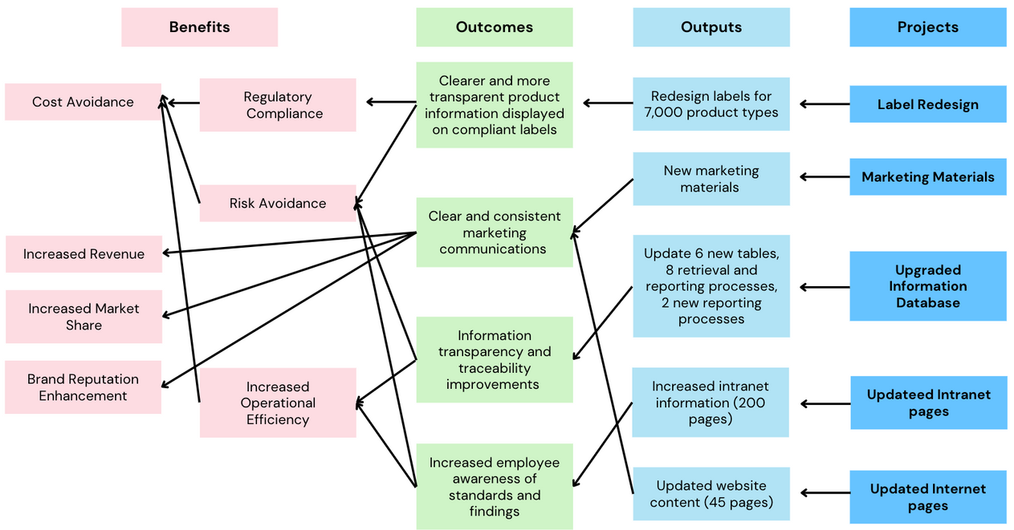
1. Introduction – Programme and Purpose
BOOP Map
Programme Introduction
A Programme initiated by R.I. Plc in response to changes in FSA food labelling regulations, which comes into effect on 1st December 2025.
involves a number of interrelated projects covering marketing, data systems and vendor management.
Programme Purpose
Achieving mandatory regulatory compliance
Protecting brand reputation
Avoiding costly penalties

Slide 3
2. Status Analysis – Change Prioritization Analysis
Change |  | Probability | Impact on Re-labelling programme |  |  | Scale | Prioritization
 |  |  | Timescale | Cost | Performance
1. Timeline Cutdown | The FSA has brought forward their deadline for compliance to the new legislation by six months. | Happened | ↓ 6 months | ↑ | Time pressures leading to failure to meet FSA standards. | VH | Must-have
2. Budget Cutdown | 20% reduction in funding. | Happened | ↑ | ↓20% | Insufficient resources leading to delays in tasks. | H | Must-have
3. New Regulation | New changes to UK food and drink labelling to come into force on 1st December 2025. | Happened | ↑ | ↑ | Need to restart label design projects. | VH | Must-have
4. Leadership | CEO Replacement and Board Reorganisation. | Happened | ↑ | - | Weakening project support or a shift in focus. | H | Should-have
5. Organisational Structure | Acquisition of PureFoods of Amsterdam. | Happened | ↓ | ↑ | Distractions from organizational integration. | M | Could-have
6. Systems | Integration of all R.I. data into PureFoods ‘world-class’ information systems. | Very high | ↓ | ↓ | Data migration risks. | H | Should-have
7. Supplier Accident | ALLPRINT Big Fire (assumption by Mike) | High | ↑ | ↑ | Unavailability of printed materials. | H | Must-have
8. Manufacturing Process Problem | Finished product samples that are inconsistent with the benchmarking to the new standards. | Very high | ↑ | ↑ | Fines for compliance failures. | VH | Must-have
9. Ingredients Data-base Problem | Insufficient technical support and team conflicts. | Happened | ↑ | ↑ | Reduced efficiency. | M | Could-have
10. Re-design and Re-print | Insufficient label space, efficiency issues, and reprinting problems. | Happened | ↑ | ↑ | Redesign and reprinting of prototypes. | VH | Must-have
Notes:
This part of the content describes the changes brought by the project and lists the priorities using MoSCoW.
Time pressures leading to failure to meet FSA standards, insufficient resources leading to delays in tasks, need for label redesign, delays in short-term decision-making, distractions from organizational integration, data migration risks, unavailability of printed materials, fines for compliance failures, reduced development efficiency, redesign and reprinting of prototypes

Slide 4
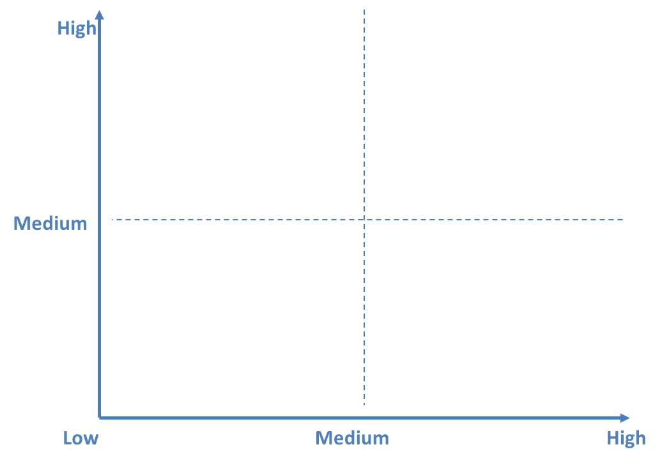
2. Status Analysis – Risk Analysis
Timeline Cutdown
Budget Cutdown
New Regulation
Supplier Accident
Manufacturing Process Problem
Re-design and Re-print
Leadership
Systems
Level of Impact
Fail to complete the project on time
1
2
1
2
5
Insufficient key resources(translation and printing)
6
3
4
3
Restart label design projects
8
7
4
Unavailability of printed materials
Fines for compliance failures
5
9
6
Repeated rework has delayed the official production
7
The reduction of project resources and priorities
8
Level of Probability
Data migration risks
The efficiency improvement
9
Notes:
This part of the content describes the risks brought by the project and lists the priorities using Risk Analysis Matrix.

Slide 5





2. Status Analysis – Organization Context (SWOT)
STRENGTHS
WEAKNESSES
S
Clear Strategic Commitment
-high priority given to compliance issues
-promoting positive industrial
Cross-functional Project Teams
- Rapid problem response capability
W
Lack of a Unified Data Platform
- Labels generated in reliance on inaccurate database information will increase the risk of FSA violations
Ambiguity of Responsibilities
Slow Brand Management and Design Process
OPPORTUNITIES
THREATS
O
Standardisation of FSA and EU Food Labelling
- Favourable to the establishment of credible brand image in the industry
System integration through the acquisition of PureFoods
-Centralised management of database
T
FSA compliance ahead of schedule
Supplier Disruption (ALLPRINT Fire)
- Rising risk of project delays and compliance breaches
Unstable Manufacture Process
- High penalty
- Reduced customer trust
Notes:
Use SWOT to analyze the organization's situation and conduct background analysis for the following actions as recommended.

Slide 6
3. Recommendation Action
Combined with R.I. plc’s SWOT analysis, design actions to deal with Must-have Changes:
Timeline Cutdown
Budget Cutdown
Amplify cross-team advantages, establish agile teams, plan sprint progress, and track regularly.
Suspend non-core business (complete Internet update), and utilize PureFoods' existing advanced systems to reduce costs.
New Regulation
Supplier Accident
Designate internal experts/groups to conduct dynamic compliance monitoring to ensure that project outcomes meet the requirements of the FSA and UN.
First, confirm whether an accident has really occurred. At the same time, contact other suppliers and discuss cooperation through the brand's influence.
Manufacturing Process Problem
Re-design and Re-print
The PureFoods system is mainly utilized to integrate data to address the disadvantage of the company's scattered data platforms.
Cooperate with the market and brands to set up a label design team to review samples and speed up process efficiency.
Notes:
Make action recommendations for changes with priorities of "Must" and "Should" (use specific tools for analysis based on the specific change, such as PBS for product-related changes and Stakeholder map for personnel changes).

Slide 7
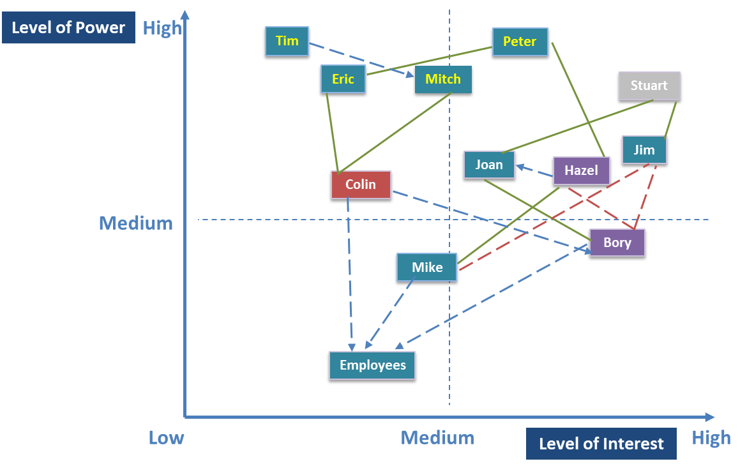
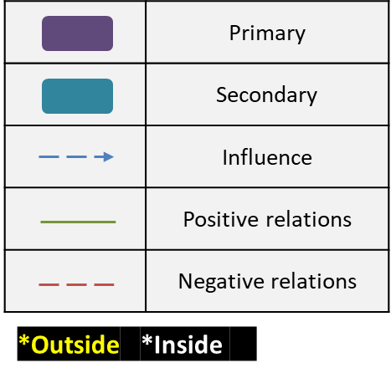
3. Recommendation Action
Systems
Leadership
opportunity
Prioritize the completion of core tasks, accelerate value delivery, and regularly explain the market-related benefits of the project to the CEO.
Through the interpersonal network, Hazel → Peter → Eric continued to increase CEO’s interest.
IT department takes the lead in completing the system connection.
Transfer data in batches. First use non-core data to test the transfer function, then transfer in batches and archive them in a timely and safe manner to avoid data loss.
Colin
Notes:
Provide solutions and analyses for the key risks listed in the risk register.
Prioritize the completion of core tasks, accelerate value delivery, and regularly explain the market-related benefits of the project to the CEO.
Through the interpersonal network, Hazel → Peter → Eric continued to win over.

Slide 8
3. Recommendation Action
Priority | Risk | Strategy | Action | Risk Trend | Risk Owner | Risk Status
1 | Fail to complete the project on time | Mitigate | Frequently track progress and implement parallel task processing. | → | Bory | Open
2 | Insufficient key resources(translation and printing) | Mitigate | Using technological tools to reduce labour costs and save more resources. | → | Joan | Open
3 | Restart label design projects | Mitigate | Design multiple universal templates for multi-product scales. | ↑ | Hazel | Open
4 | Repeated rework has delayed the official production | Mitigate | Break down the communication barriers between the market and the brand. | ↑ | Colin | Open
5 | Fines for compliance failures | Mitigate | Complete the update of the production and manufacturing process. | ↓ | Jim | Open
6 | Unavailability of printed materials | Transfer | Transfer to the contract supplier, lock in costs and delivery responsibilities. | ↑ | Colin | Open
7 | The efficiency improvement | Enhance | Integrate the PureFoods system to shorten the development cycle. | ↑ | Mike | Open
Notes:
Provide solutions and analyses for the key risks listed in the risk register.
Fail to complete the project on time
Insufficient key resources(translation and printing)
Restart label design projects
Fines for compliance failures
Repeated rework has delayed the official production
Unavailability of printed materials

Slide 9
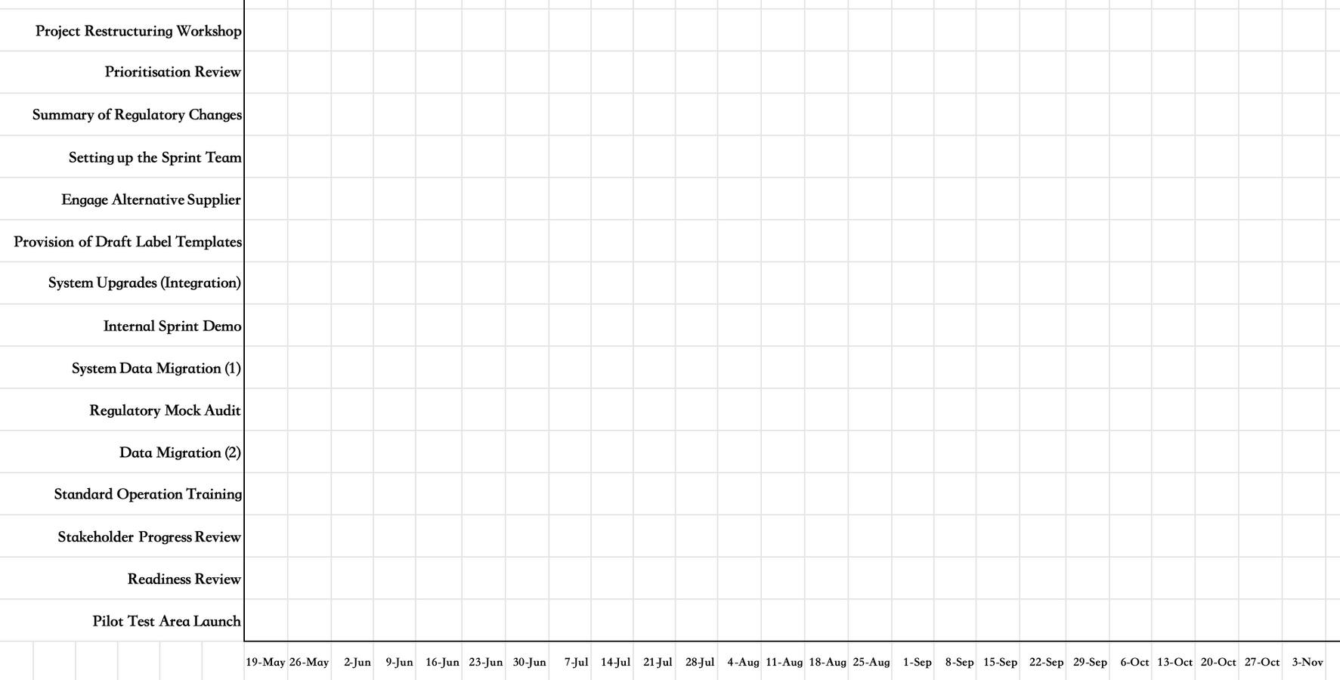
4. Next Step Plan
6-Month Gantt Chart
Phase 1
Month 1 - 2
Phase 2
Month 3 - 4
Phase 3
Month 5 - 6
Notes:
Use a Gantt chart to plan actions for the next six months.

Slide 10

5. CONCLUSION
WE BELIEVE
Despite changes such as regulatory changes, timeline and budget cuts, management and organization structure change … Happened
The Re-labelling Programme can still achieve the objective of “All labelling used on R.I’s products correctly reflect the ingredients used in their production” by identifying changes and risks, priority analysis, organizational context analysis, designing change actions and risk monitoring based on the company's situation.

Slide 11
Reference
Case Material
PART C Ready Foods Case Study V2.1 2021 06PPS
Case Material
A READYFOODS Case Study V2.0 Part A & B v2
WMG Slides
1.2 Week 1 Session 1 Corporate and Project Strategy v1
WMG Slides
2.0 Week 1 Session 2 Strategy to projects and Programme Management
WMG Slides
Session 5 - PPS2425 Risk DRAFT v0.6
WMG Slides
PPS soft sessions v13 (2025) - block mode - Engaging Stakeholders
WMG Slides
Week 4 Session 7 Change Control

Slide 12

THANK YOU
FOR YOUR ATTENTION AND PARTICIPATION
ANY QUESTIONS?

